Slide 1

Walmart Sales Forecasting and Optimization
Leveraging Machine Learning for $7.1M Projected ROI

Slide 2
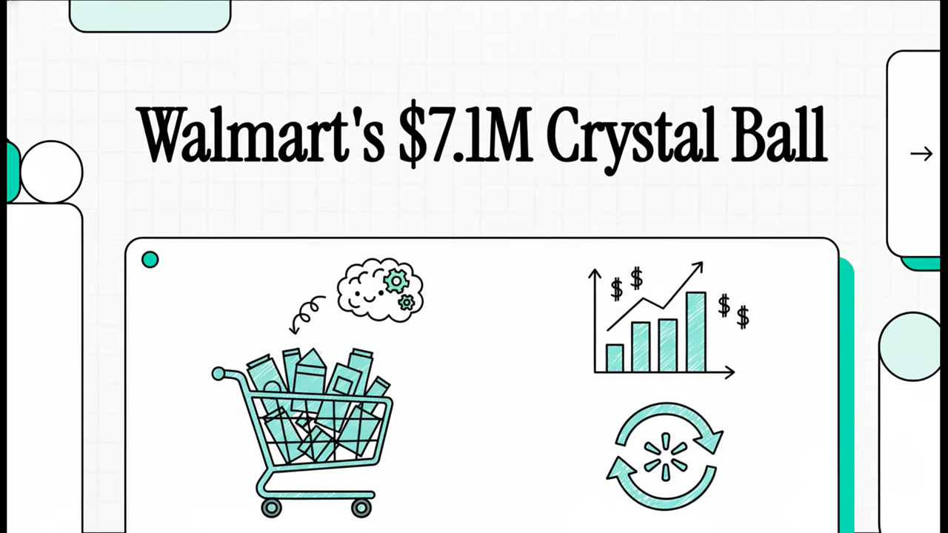
Video

Slide 3
Executive Summary
The Problem: Inaccurate sales forecasts causing stockouts/overstocking.
The Solution: End-to-End ML Pipeline (Random Forest).
The Result: 99.96% Accuracy / $106.77 MAE.
The Value: Production Ready and Scalable.

Slide 4

Business Challenge
Before ML: High operational costs, manual planning, inventory waste.
Objectives: Achieve a $R^2 > 0.95$ to drive 35% reduction in stockouts.
Scope: Predicting weekly sales for 45 stores/99 departments.

Slide 5
Data Strategy at Scale
421K
91
100%
Training Records
Engineered Features
Data Completeness
Cleaned & Merged
From 10 Original Features
Zero Missing Values

Slide 6
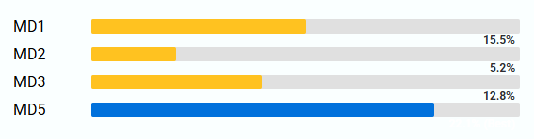
Key Business Insights
Seasonality
Promotion
Q4 sales are 35-40% higher than Q1
Holiday Impact
Sales are +7.13% higher on average during holiday weeks.
Markdown effects are highly variable and key to prediction

Slide 7
Model Selection and Performance
Model Tested
Random Forest, XGBoost, LightGBM.
Champion
Random Forest Regressor.
Key Matrics
$$R^{2}=\frac{0.9996}{MAE}=\$106.77$$
𝑅^2=0.9996/𝑀𝐴𝐸=$106.77
Why it Works
Captures complex integrations (e.g. Promotion + Holiday).

Slide 8
MLOps and Deployment (Production Readiness)
Tracking: MLflow for robust experiment management.
Serving: FastAPI API (fast inference <10ms).
User Interface: Interactive Streamlit Dashboard for business users.
Containerization: Docker for easy, one-command deployment.

Slide 9

Live Demo
Action: Show the Streamlit Dashboard/API output.
Focus: Demonstrate prediction capability by inputting new data (e.g., a holiday week vs. a regular week) and showing the quick, accurate result.
Link: walmart-sales-forecasting-ml.streamlit.app

Slide 10
Business Value & ROI
Inventory Savings: $2.4M annual savings projected.
Staff Efficiency: 20% optimization in labor costs.
Net Value: Projected $7.1 Million ROI.

Slide 11
Future Roadmap
Data: Integrate social media/sentiment analysis.
Model: Explore advanced LSTM/Transformer models.
Scaling: Move to enterprise-grade Cloud MLOps Platform (AWS/Azure).

Slide 12

Project Leadership & Team
Development Team (DEPI Initiative)
Moaaz Bakry Karim Azab Ahmed Haitham Yahia Shazly Youssef Hamdy
Instructor Acknowledgment
Eng. Islam Adel
Track: Data Science / Machine Learning
Digital Egypt Pioneers Initiative (DEPI)
This project was completed as part of the Data Science / ML Track (Round 3) under the supervision of the Ministry of Communications and Information Technology (MCIT).

Slide 13
Thank You & Q&A
Summary: We delivered a high-impact, production-ready solution.
Open for questions.

